Slide 1

Interpreting Object-level Foundation Models via Visual Precision Search
CVPR 2025

Slide 2

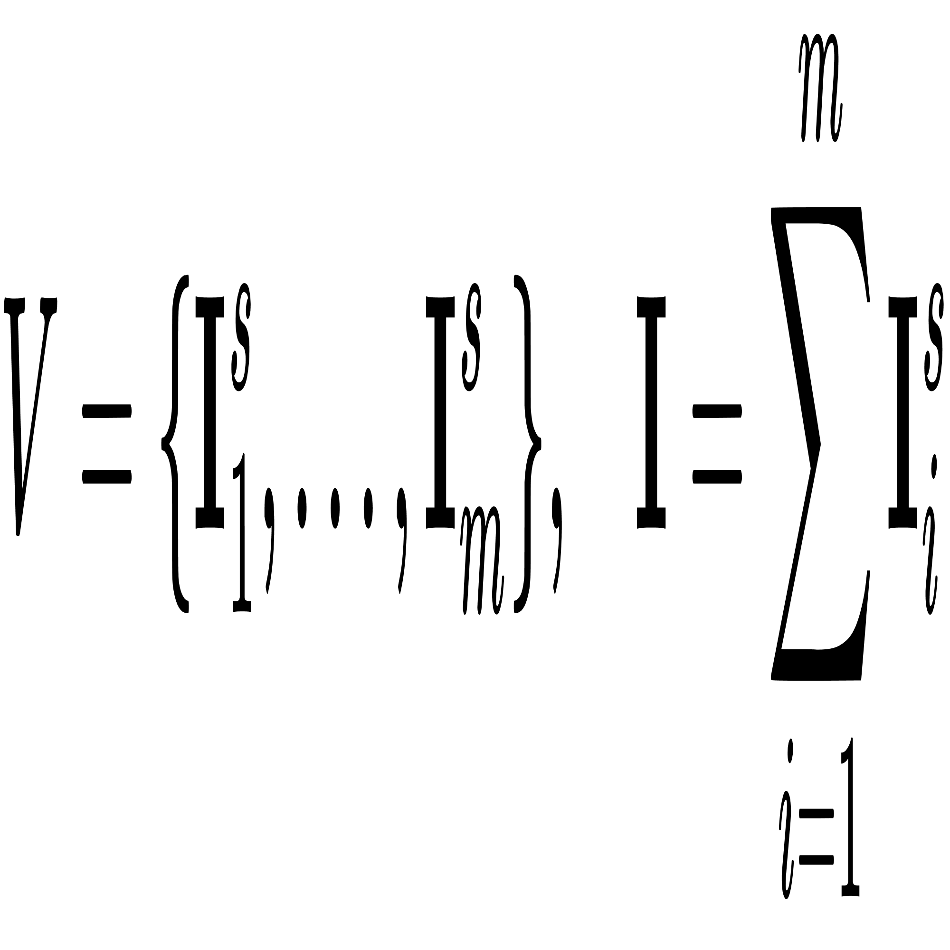
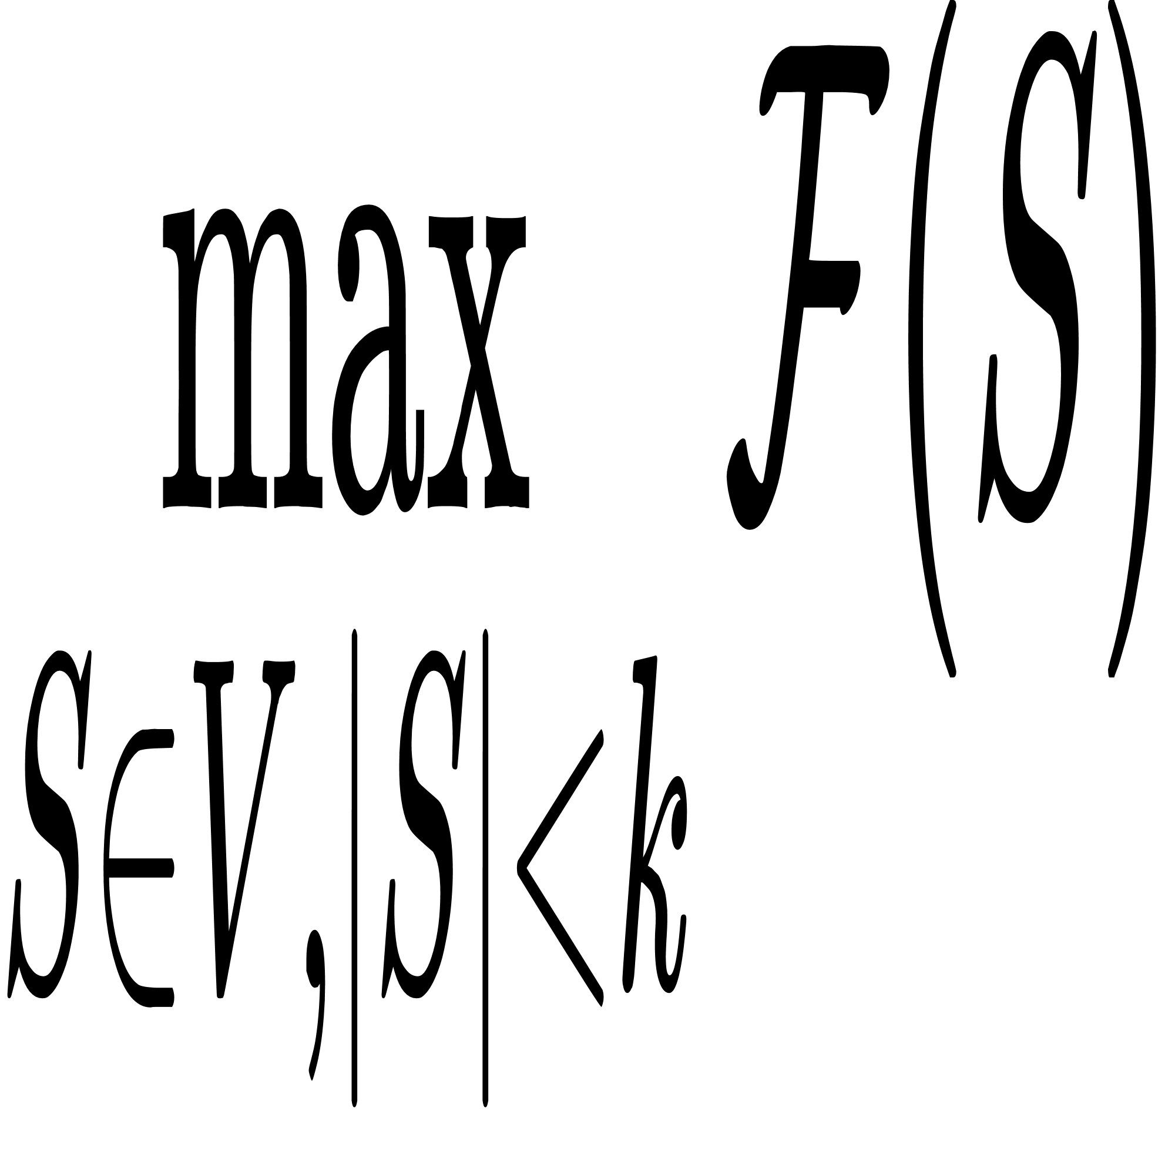
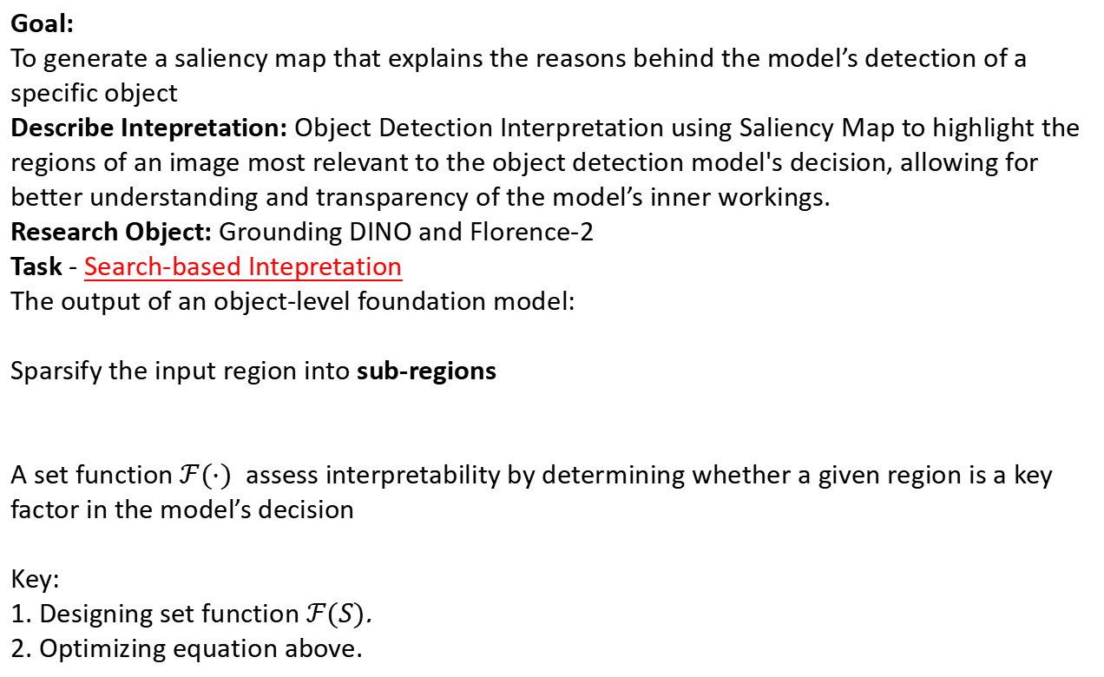
Problem Formulation
Goal:
To generate a saliency map that explains the reasons behind the model’s detection of a specific object
Describe Intepretation: Object Detection Interpretation using Saliency Map to highlight the regions of an image most relevant to the object detection model's decision, allowing for better understanding and transparency of the model’s inner workings.
Research Object: Grounding DINO and Florence-2
Task - Search-based Intepretation
The output of an object-level foundation model:
Sparsify the input region into sub-regions
A set function $ℱ(⋅)$ assess interpretability by determining whether a given region is a key factor in the model’s decision
Key:
1. Designing set function $ℱ(S)$.
2. Optimizing equation above.
Motivation: Generates accurate attribution maps with fewer regions

Slide 3
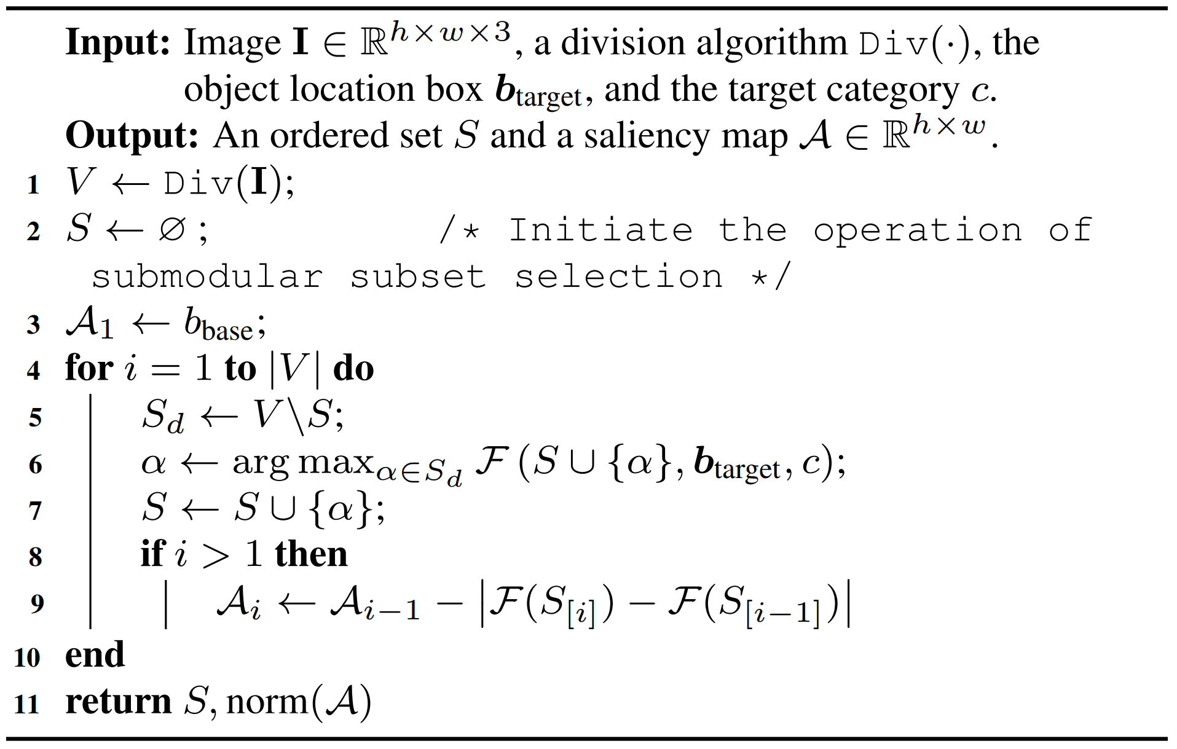
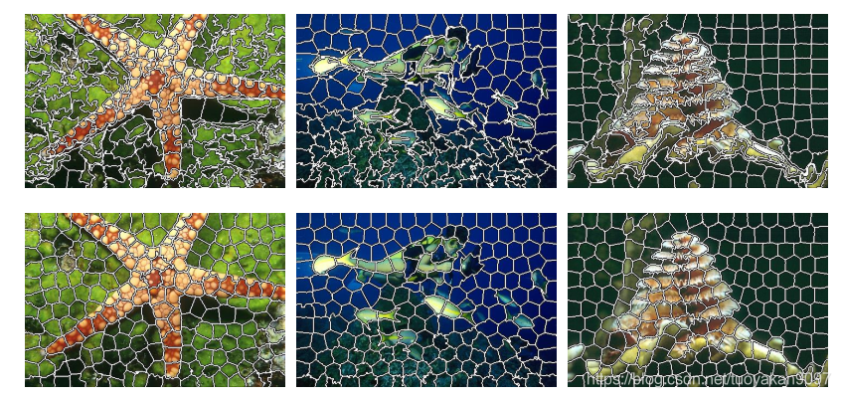
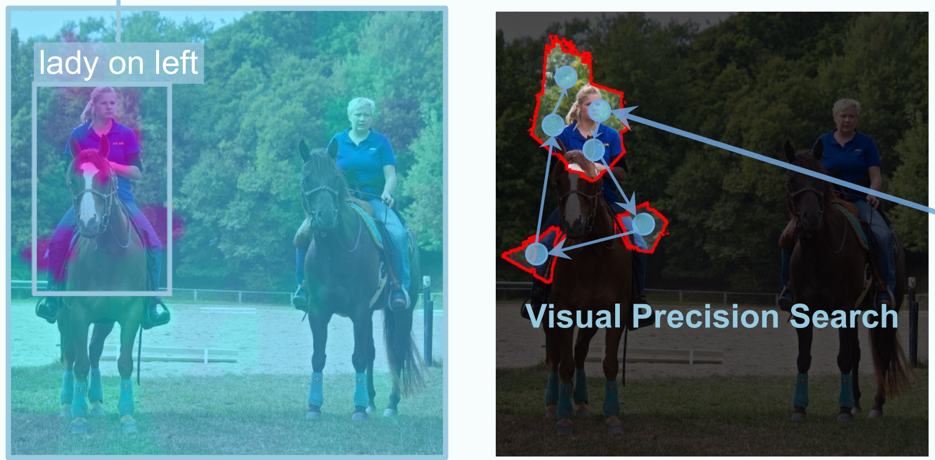
VPS: Visual Precision Search
Division algorithm:
SLICO superpixel segmentation algorithm
Algorithm Demonstration:

Slide 4


Method - Submodular Function $ℱ(S)$
Clue Score
Collaboration Score
Submodular Function

Slide 5
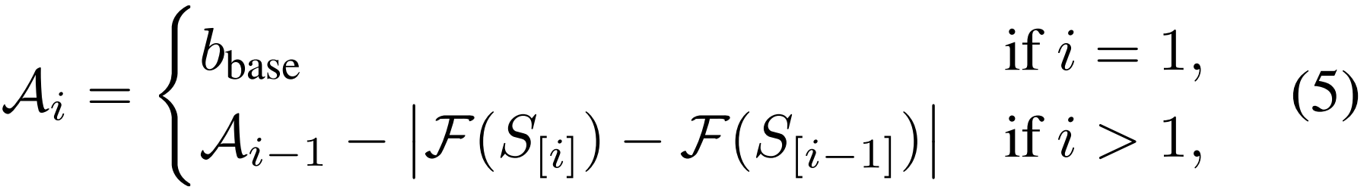
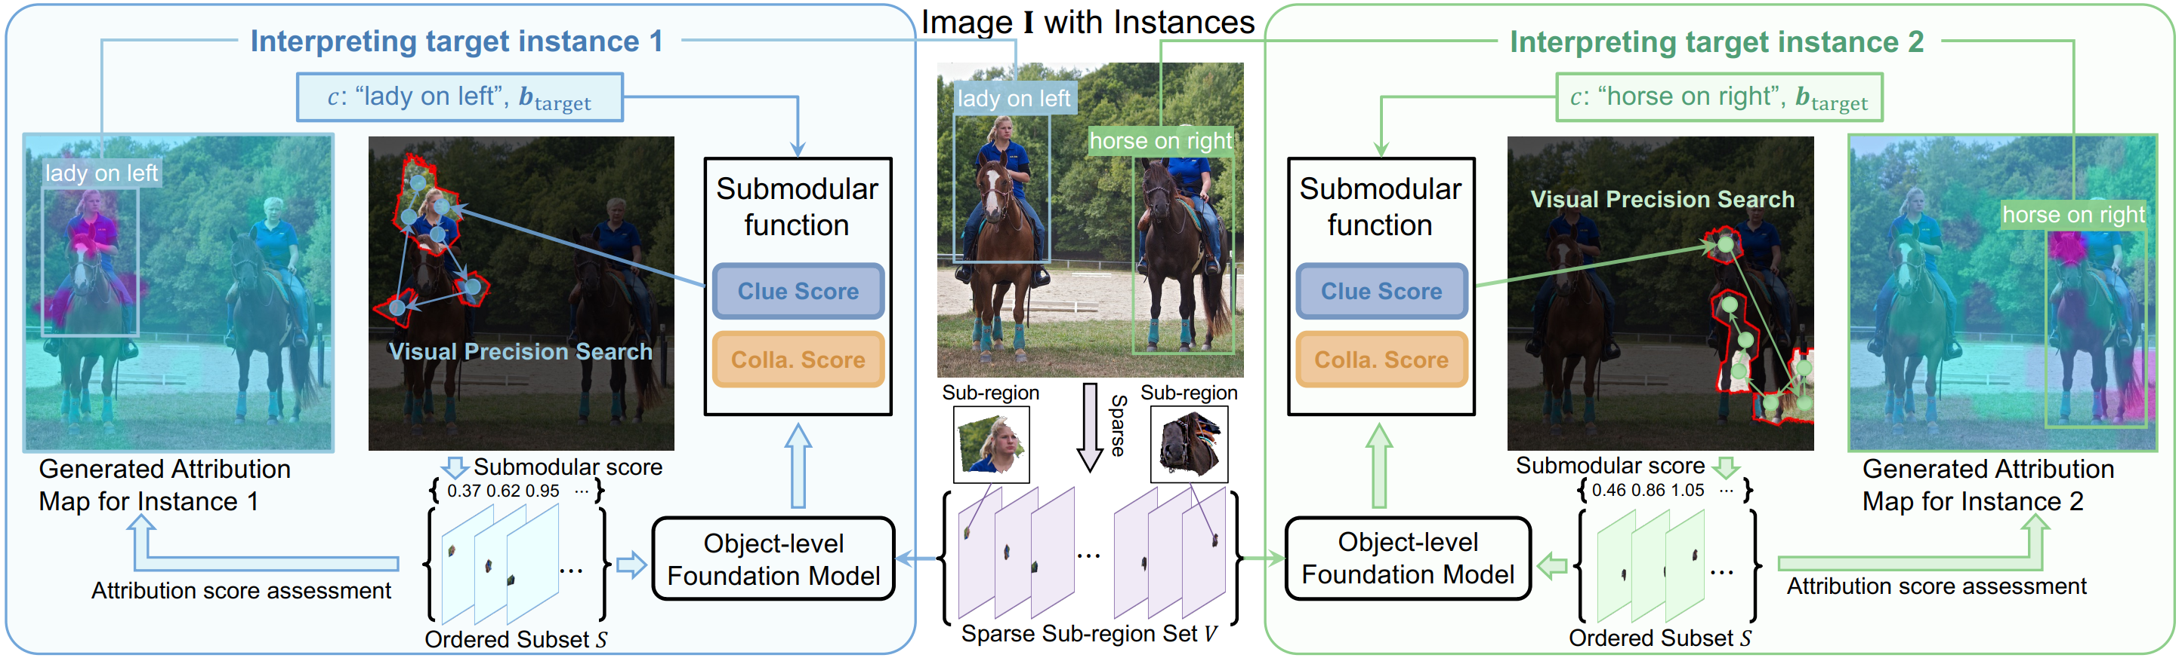
Method - Saliency Map Generation

Slide 6

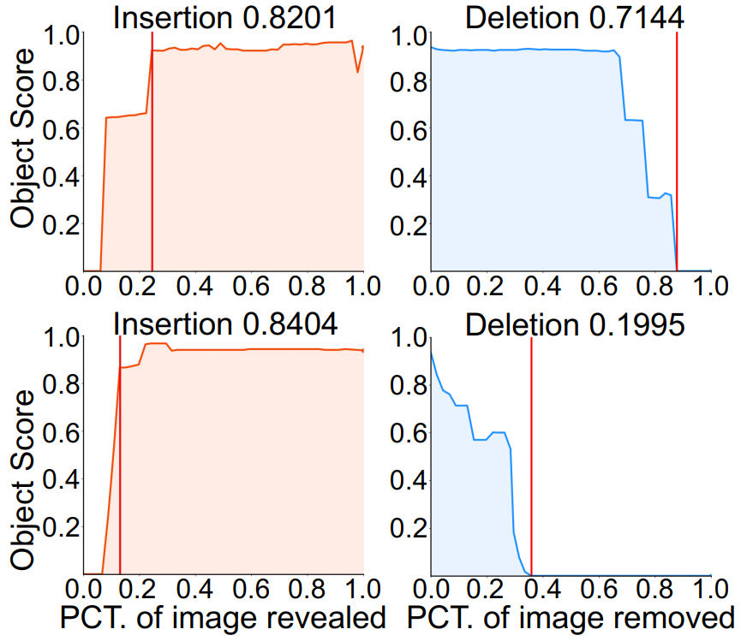
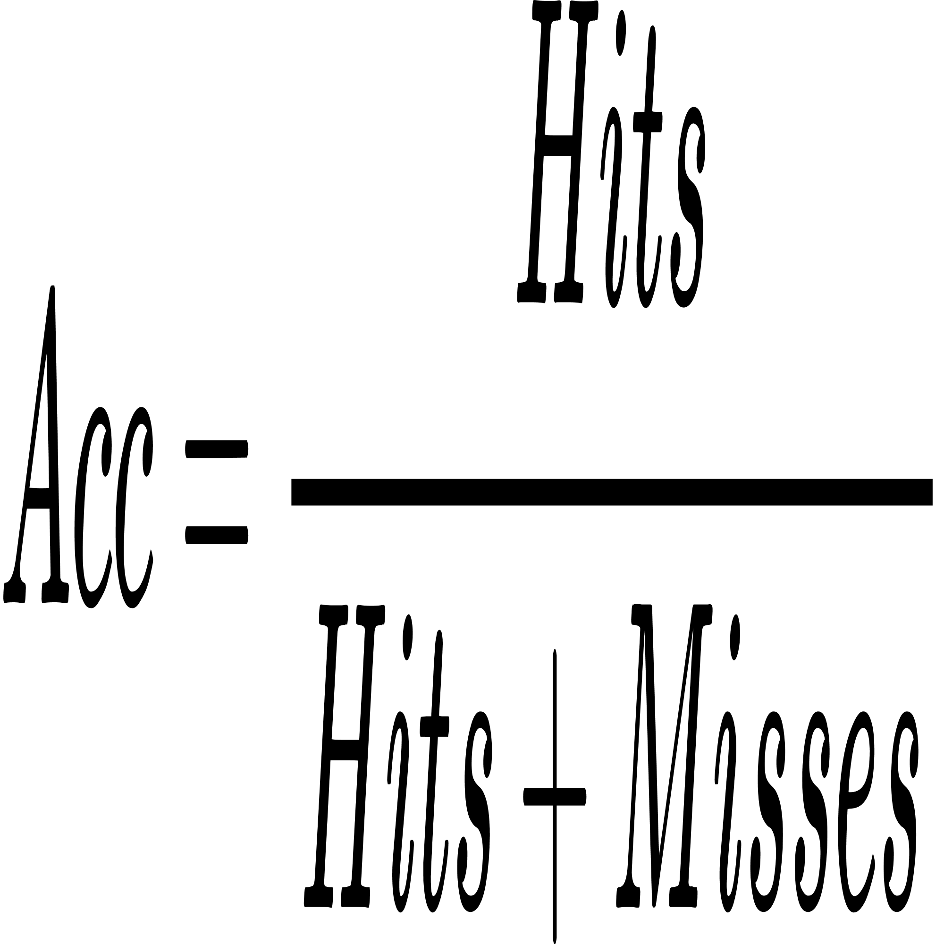
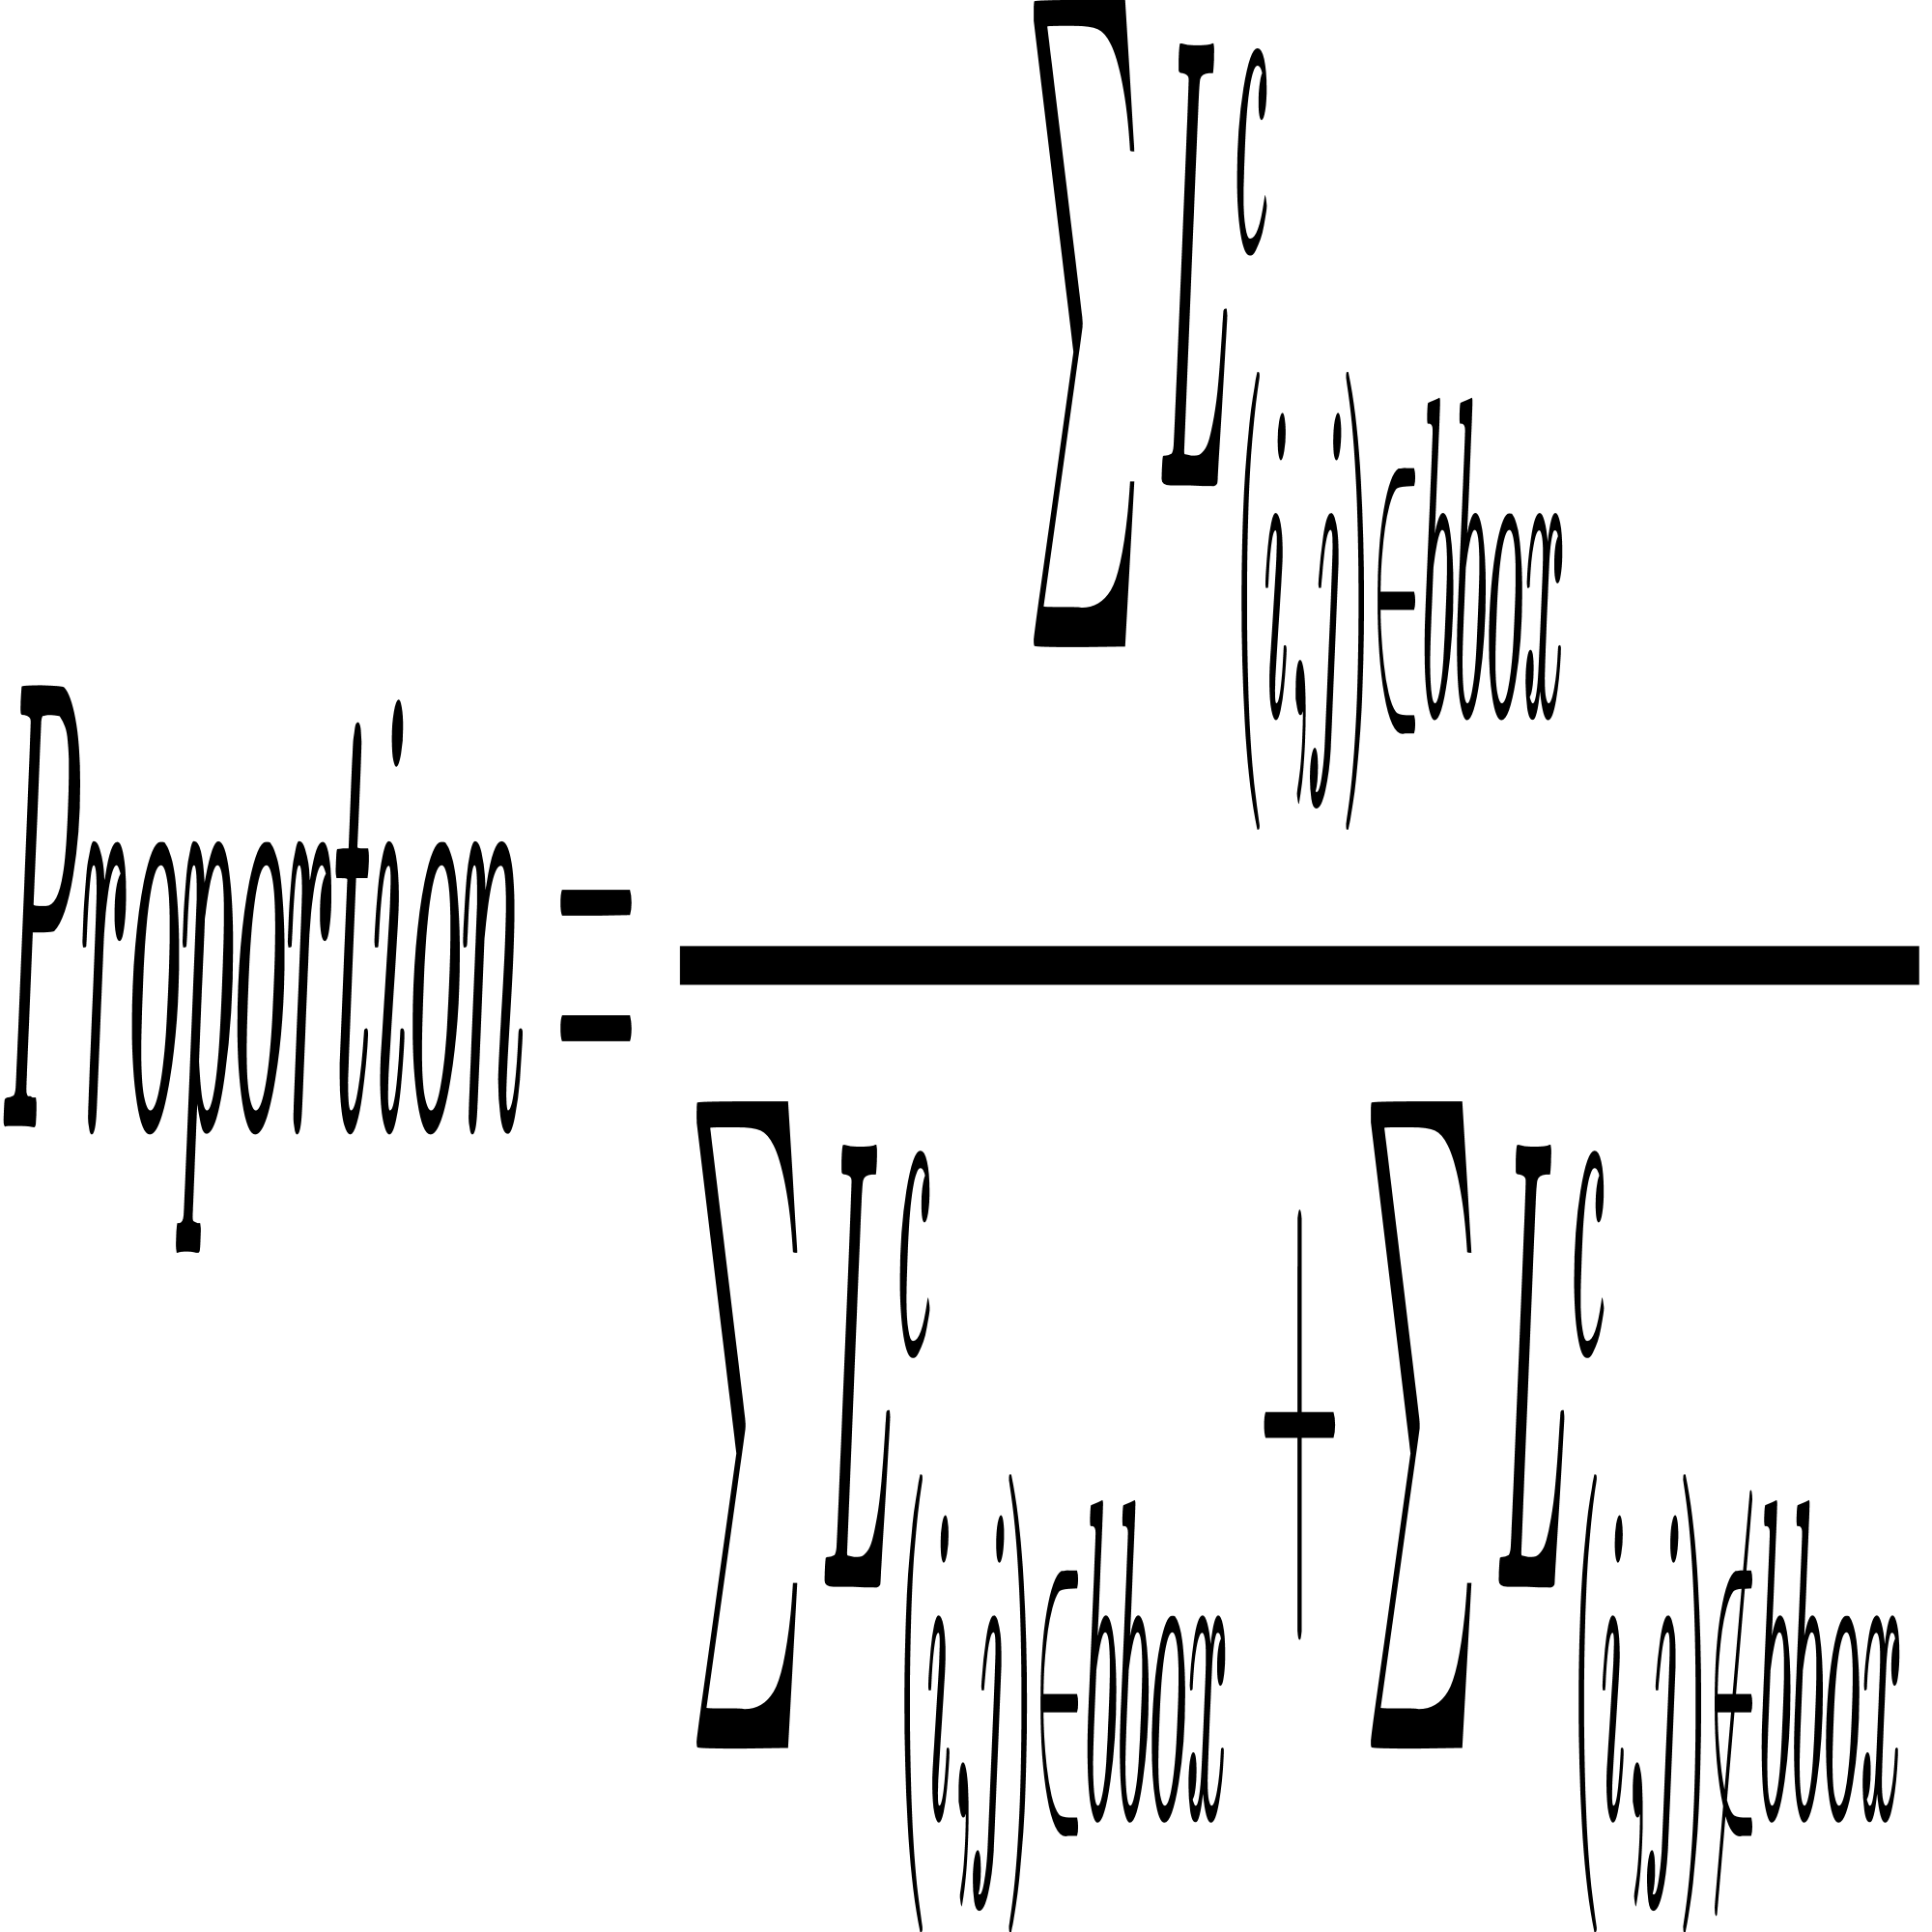
Evaluation Metrics
Faithfulness metric
Insertion scores
Deletion scores
Location Metrics
Point Game
Energy Point Game
Object Score:
Calculate AUC (Area Under Curve)

Slide 7
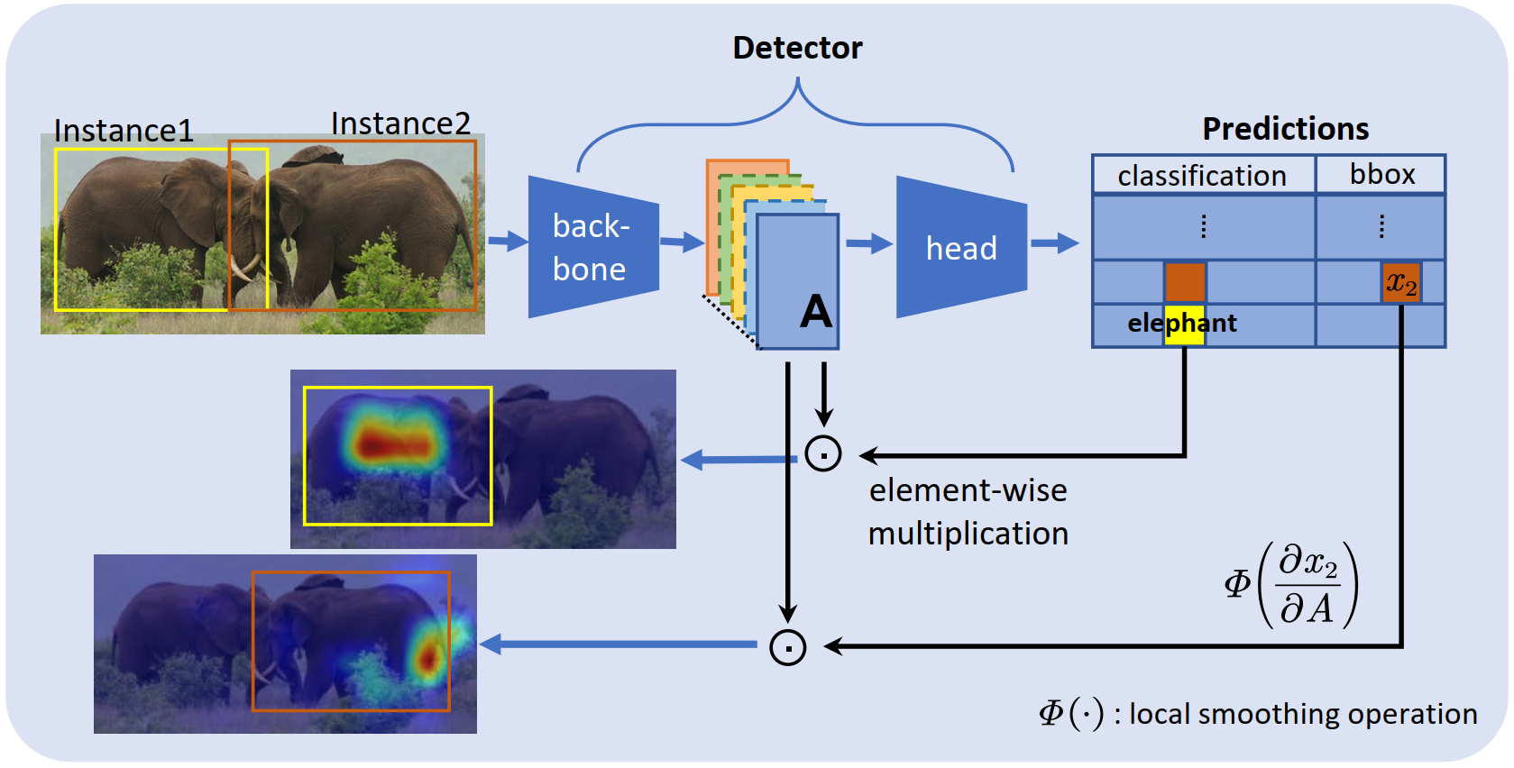
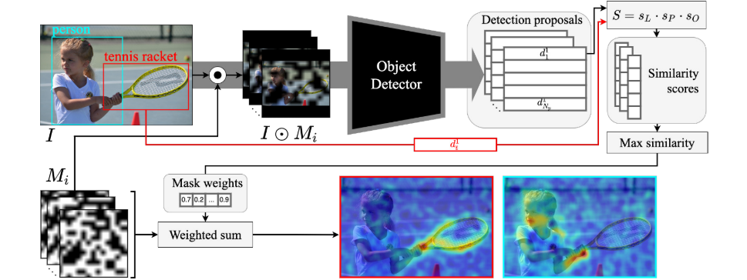
Methods for Comparing with VPS
Gradient-based methods:
Grad-CAM
SSGrad-CAM++
ODAM
Perturbation-based methods:
D-RISE
D-HSIC
ODAM
D-RISE

Slide 8
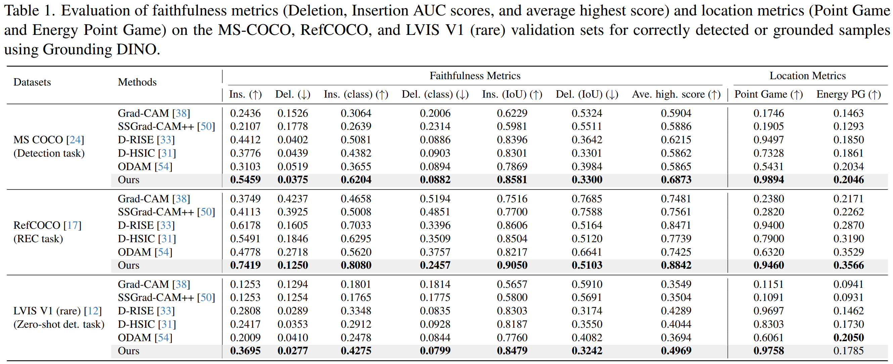
Experiment Results
Results of Grounding DINO for interpreting object localization tasks on the MS COCO, RefCOCO, and LVIS datasets

Slide 9
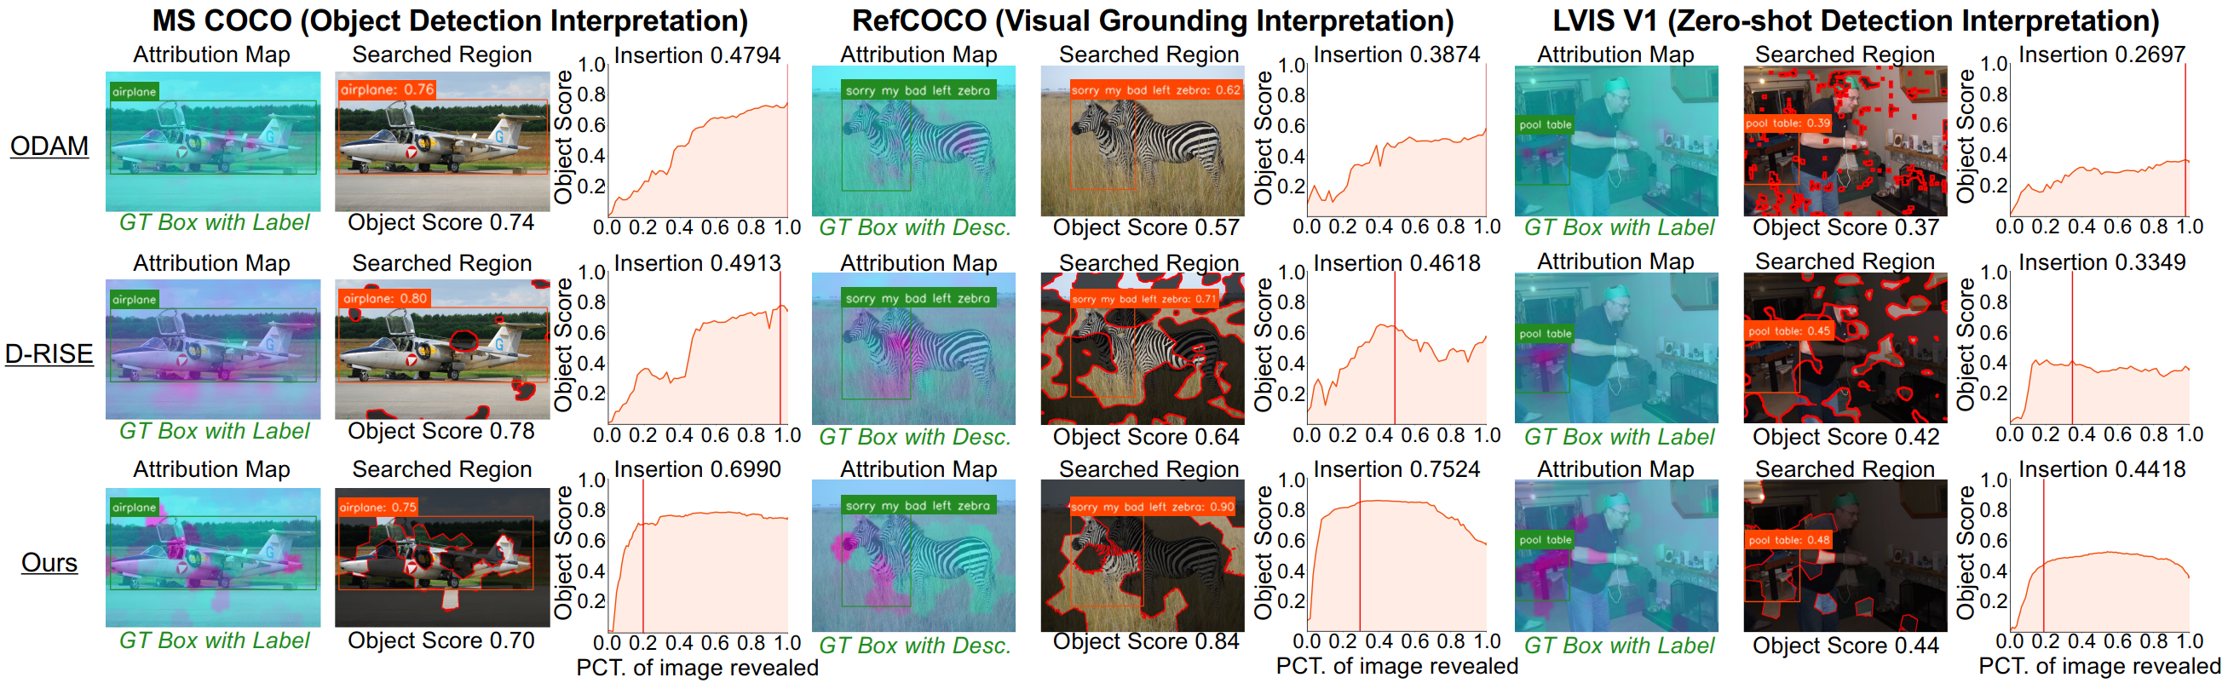
Experiment Results
Visualization results of Grounding DINO for interpreting object localization tasks on the MS COCO, RefCOCO, and LVIS datasets

Slide 10
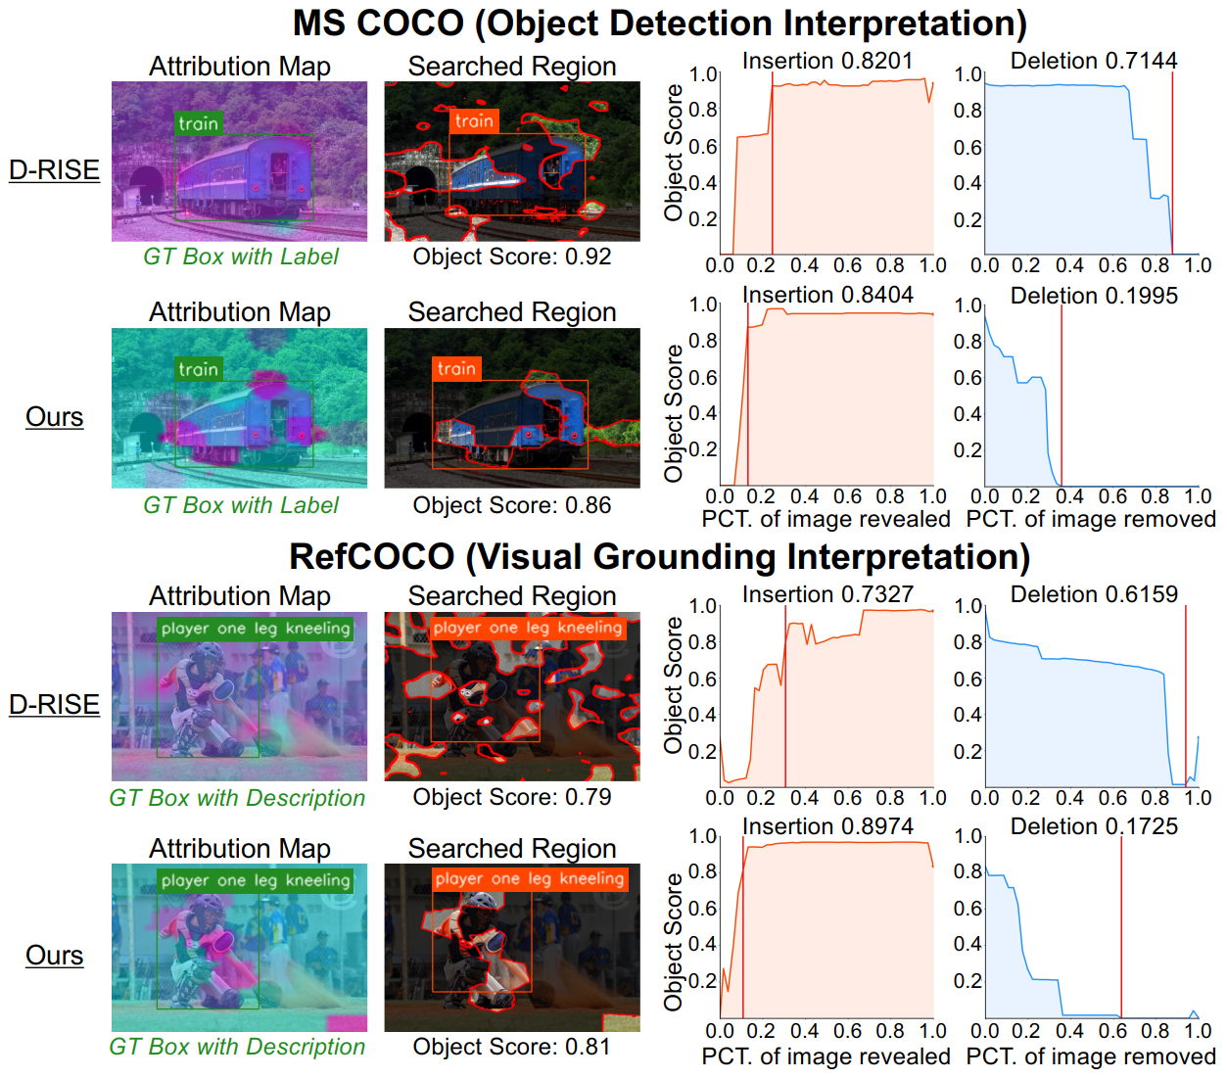
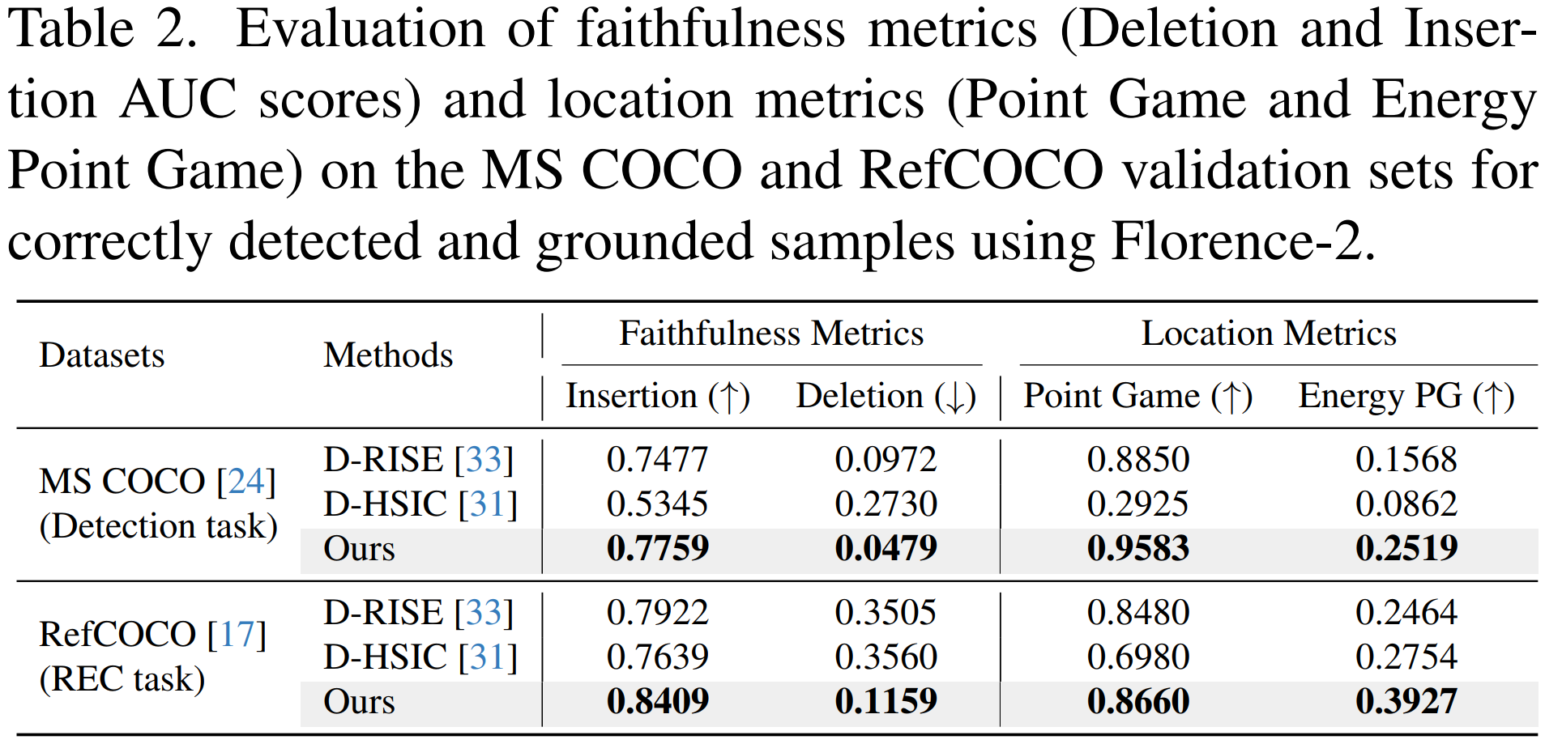
Experiment Results
Interpreting object
localization tasks using Florence-2
Cyan region in the saliency map highlights the regions responsible for the model’s detection failure

Slide 11
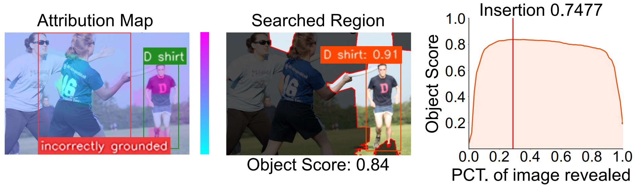
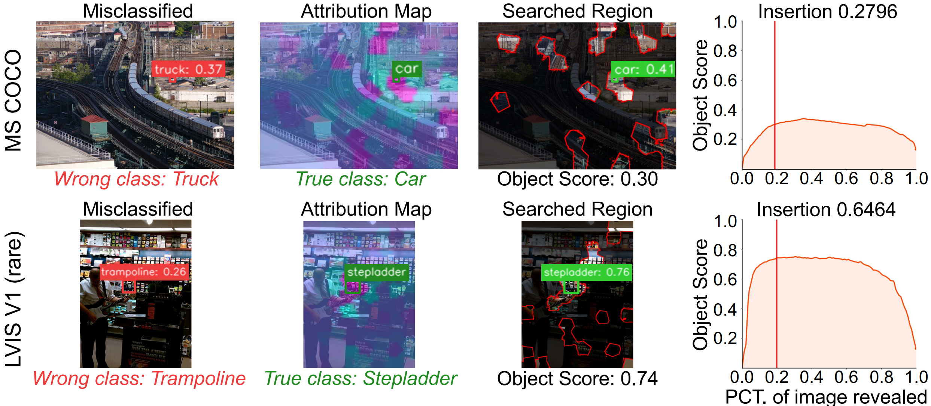
Experiment Results
Grounding DINO
Interpreting REC Failures
REC (referring expression comprehension)
Due to interference from other objects in the scene that become entangled with the text
Grounding DINO Misclassified Interpretation
The background surrounding the object interferes with the model’s decision-making

Slide 12
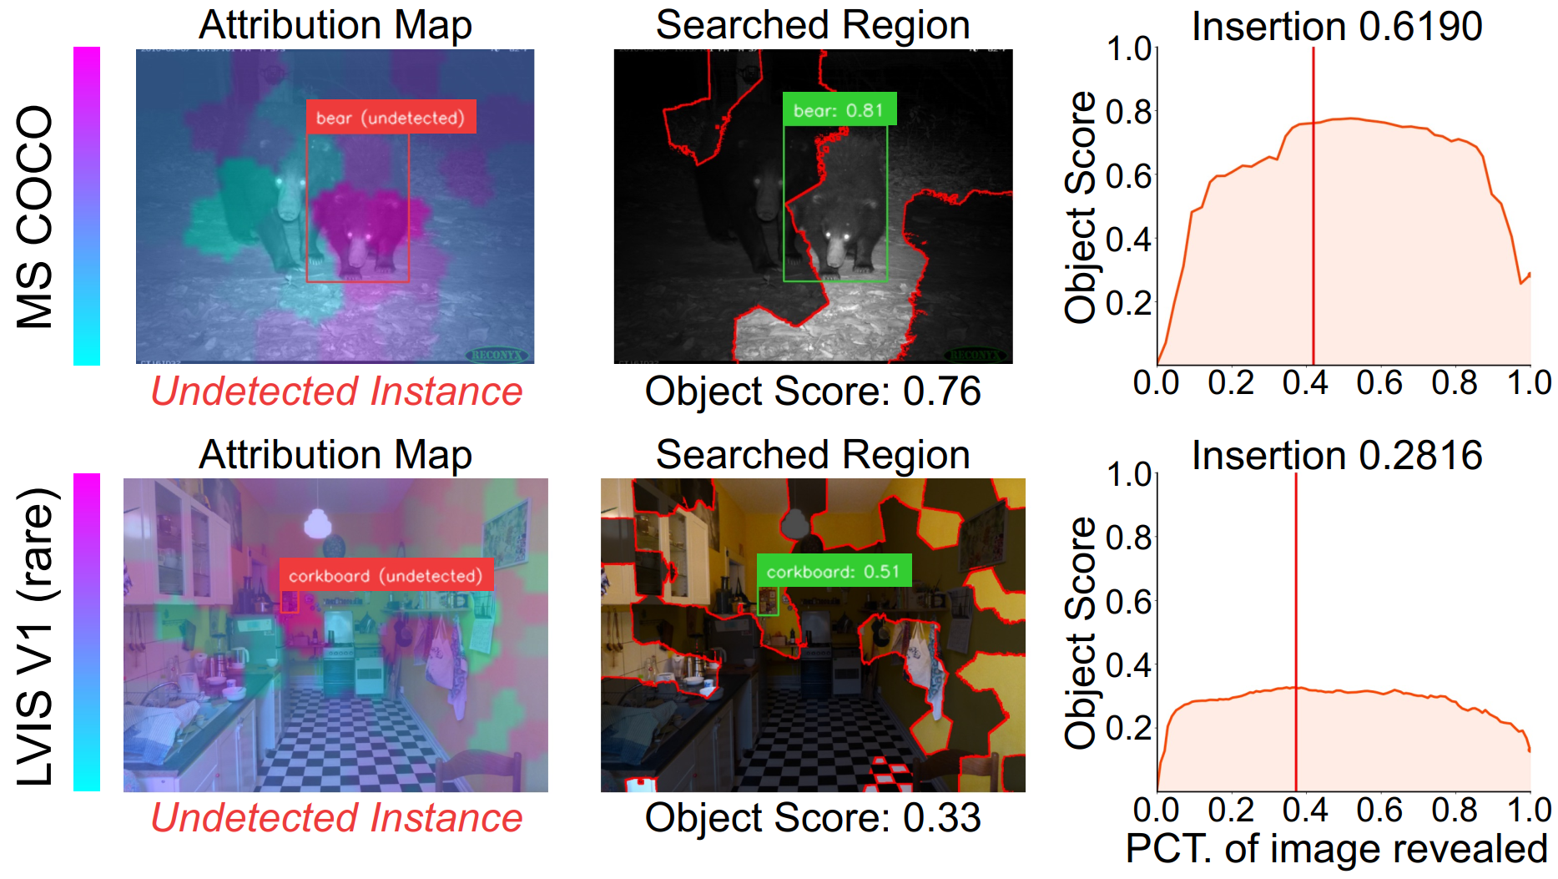
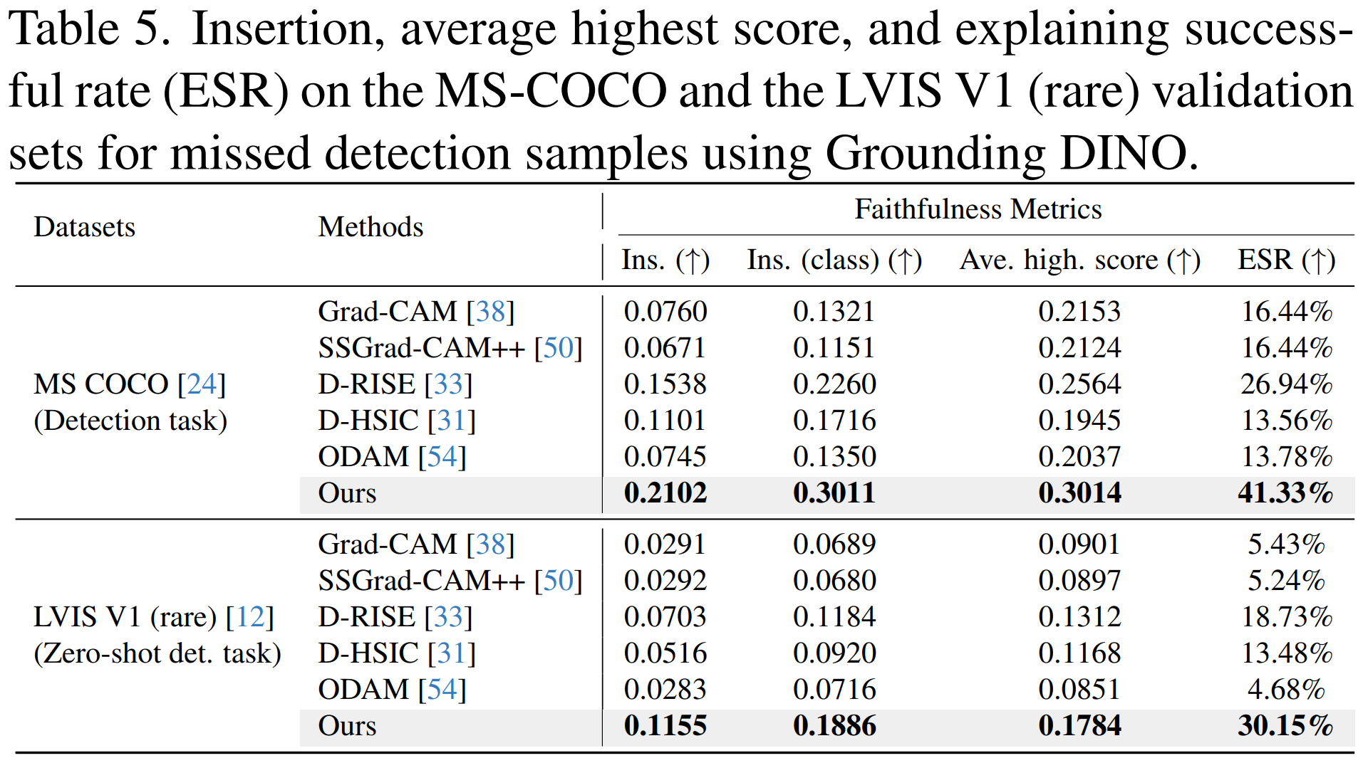
Experiment Results
Grounding DINO Undetected Interpretation
Cyan region in the saliency map highlights the regions responsible for
the model’s detection failure

Slide 13
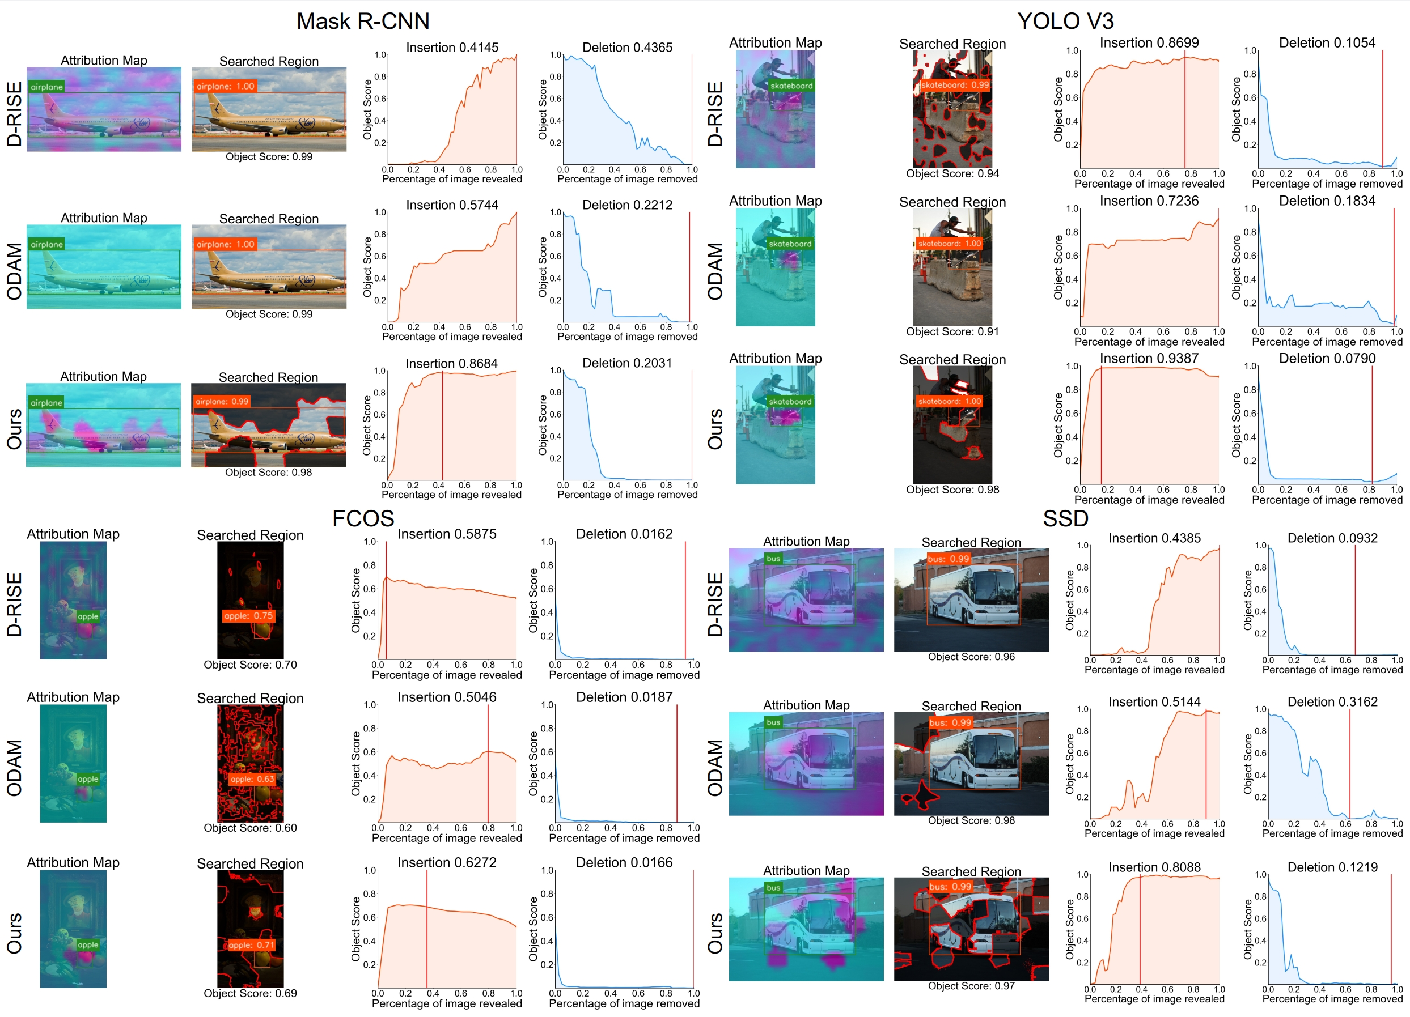
Experiment Results
Mask R-CNN & YOLO V3
Interpretation

